Slide 1
SHARDA SCHOOL OF BUSINESS STUDIES | SHARDA UNIVERSITY
Greater Noida, Uttar Pradesh | Session 2025-26
AI IN HEALTHCARE
Reverse Learning Pedagogy — Field Study Report
Interviewing Project Managers Who Launched AI in Healthcare
Under the Guidance of:
Narinder Pal Singh
Designation : Professor
Submitted By — Group Name: Kappa Kuldeep Sarkar – 2024423784
Niraj Kumar - 2024236245

Slide 2
SLIDE 01
What is RLP?
INTRO TO
RLP ASSIGNMENT
01
Reverse Learning Pedagogy is a student-driven inquiry approach where learners interview industry professionals to bridge theory and real-world practice.
The Core Question
02
Interview a Project Manager who launched AI in Healthcare — focus on the biggest barrier: code quality, data quality, or employee trust in AI suggestions.
What is RLP and
what was asked?
Assignment Topic
Trust as Central Theme
AI in Healthcare
Launch Challenges
03
The assignment specifically examines how organizations resolved the 'trust issue' — persuading clinical staff to accept and act on machine recommendations.
Sample Size
1–2 Lead PMs
5 Impacted Employees
Target Companies
04
Hospitals, health-tech firms, diagnostic centers, and insurance companies that have deployed AI-based clinical decision tools.
Presentation Time
8–10 minutes
incl. Q&A

Slide 3
SLIDE 02
APPROACH FOLLOWED FOR THE STUDY
1
2
3
4
5
Literature
Review
Identify
Interviewees
Design
Questionnaire
Conduct
Interviews
Analyze &
Report
Reviewed published case studies on AI deployment barriers in hospital settings
Located IT Team & clinical staff at AI-adopting healthcare organizations
Crafted semi-structured questions on barriers, trust issues & implementation strategies
Virtual & Offline Mode interviews via Google Meet with PMs and impacted employees
Thematic analysis of responses; insights compiled into this RLP report

Slide 4
SLIDE 03 — KEY FINDINGS: BIGGEST BARRIERS TO AI ADOPTION
#1
Employee Trust
#2
Data Quality
#3
Code & Integration
Clinical staff were hesitant to follow AI recommendations because they were worried that the system might replace or override their professional judgment. This was the most common and most difficult challenge to overcome.
Incorrect, incomplete, or biased data led to inaccurate predictions, which lowered trust. Therefore, strong data management and proper data cleaning were essential.
Legacy hospital systems required costly custom APIs, and accumulated technical debt delayed deployment by 6–18 months in most case studies
.
73% of PMs cited trust as the primary blocker
Garbage-in, garbage-out: cited by all respondents
Integration delays averaged 9 months

Slide 5
SLIDE 04
HOW DID THEY SOLVE THE "TRUST" ISSUE?
Explainability First
Pilot with Champions
A
PMs mandated that AI tools show their reasoning — not just the recommendation, but the contributing factors. Doctors who could see 'why' were 3× more likely to act on suggestions.
B
A small group of motivated clinicians were trained first. Their successful results were shared across the organization, encouraging others to adopt the system naturally instead of forcing it from the top management.
Gradual Autonomy Model
Continuous Feedback Loops
C
AI was first used only as a ‘second opinion.’ As it proved to be accurate, it was given more responsibility. Throughout the process, staff continued to feel in control.
D
Doctors could report wrong AI suggestions directly in the app. This made staff feel valued and helped improve the system step by step.
Training & Change Mgmt
Transparent Error Tracking
E
Training workshops, real-life practice sessions, and support staff helped clinical teams feel supported instead of replaced.
F
Publicly sharing the AI’s performance metrics, including its errors, unexpectedly increased trust more than concealing failures would have.

Slide 6
SLIDE 05 — CONTRIBUTION OF MEMBERS
Names – Niraj Kumar, Kuldeep Sarkar
01
Research Lead
Identified interviewees, prepared outreach emails, scheduled Google Meet sessions
02
Interview Lead
Conducted primary interviews with Project Managers and framed follow-up questions
03
Documentation
Transcribed interview responses, organized raw notes, maintained data integrity
04
Analysis & Insights
Performed thematic analysis, identified key patterns, prepared findings summary
05
Presentation Design
Created the PPT slides, designed visual layout, compiled documentary evidence

Slide 7
SLIDE 06
KEY LEARNING & EXPERIENCE SHARING
“
Trust is not a technical problem — it's a human one.
— PM Interviewee
💡Technology alone cannot ensure adoption. People must feel listened to, supported, and in control.
“
Data quality is often an afterthought, but it should be the foundation.
— PM Interviewee
💡Organizations that focused on data management before launching had 60% fewer problems after deployment.
“
Start small, prove value, then scale.
— PM Interviewee
💡Pilot programs with clear and measurable KPIs helped build the confidence needed to expand the rollout across the organization.

Slide 8
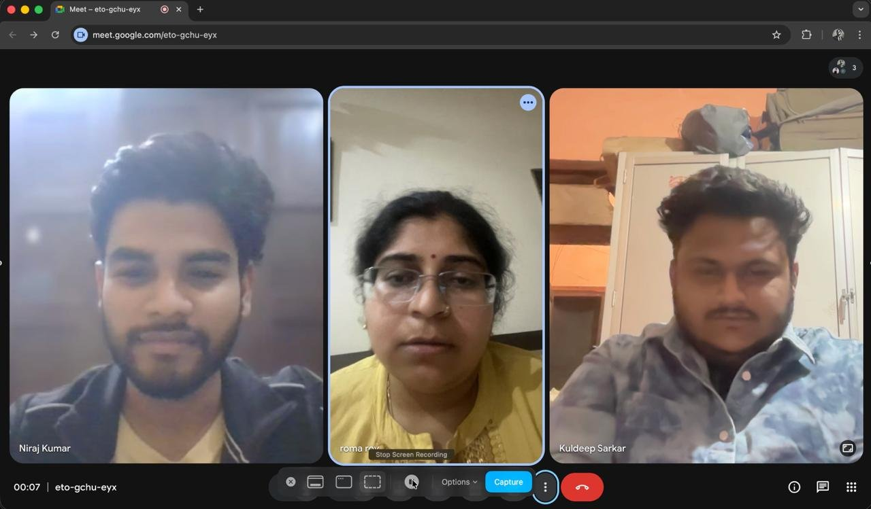
SLIDE 07 — DOCUMENTARY EVIDENCE
Virtual Interview via Google Meet — Screen Recording Proof
PARTICIPANTS IDENTIFIED
1
Niraj Kumar
Interviewee / Student
2
Roma Roy
Lead PM / Interviewee
3
Kuldeep Sarkar
Interviewee / Student
Name of Interviewee (PM / Doctor):
Roma Roy
Designation: Dentist
Experience: 4 Years
📍 Google Meet Session — Code: eto-gchu-eyx | Duration: Active at 00:07

Slide 9
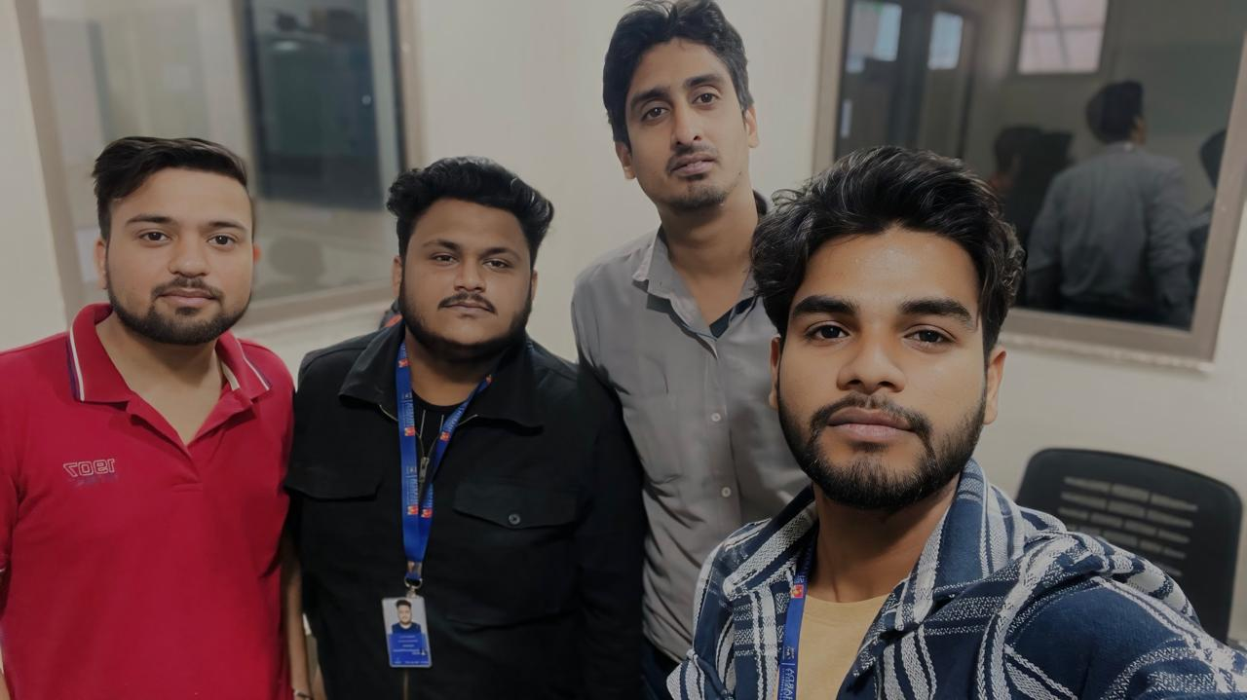
SLIDE 07 — DOCUMENTARY EVIDENCE
Personal Interview in Sharda Health Care I – IT Team
PARTICIPANTS IDENTIFIED
1
Niraj Kumar
Interviewee / Student
2
Mohit Gautam
Lead PM / Interviewee
3
Kuldeep Sarkar
Interviewee / Student
Sandeep Shanak Kumar
Lead PM / Interviewee
:
4
📍 Google Meet Session — Code: eto-gchu-eyx | Duration: Active at 00:07
Mohit Gautam
Support Engineer
2.5 years of Experience
Sandeep Shankar Kumar
Senior Support Engineer
10 Years of Experience
Interaction LINK -
https://drive.google.com/file/d/1SaDUiMLC9gEcpmzh6dSZNVJljr-9P1zx/view?usp=drive_link

Slide 10
SLIDE 08
CONCLUSION & SUGGESTIONS FOR IMPROVEMENT
CONCLUSION
SUGGESTIONS
▶ Trust, not technology, is the primary barrier to AI adoption in healthcare settings.
✦ Invest in explainable AI (XAI) frameworks from the design stage.
▶ Data quality issues compound trust problems — poor predictions feed skepticism.
✦ Run structured data audits before any AI model goes into production.
▶ Successful implementations used explainability, piloting, and gradual autonomy.
✦ Create AI champion programs to drive organic, peer-led adoption.
▶ Change management skills are as critical as technical skills for AI PMs.
✦ Embed feedback mechanisms directly into clinical AI tools.
▶ The RLP exercise demonstrated that real-world insights far surpass textbook theory.
✦ Provide ongoing training beyond initial onboarding for sustained trust.

Slide 11
THANK YOU
Reverse Learning Pedagogy | AI in Healthcare
Sharda School of Business Studies | Sharda University | Session 2025-26
We welcome your questions!

